Slide 1
Peer Reviewed and Open Access in Alma and Alma Analytics
Yoel Kortick
Senior Librarian

Slide 2
Peer Reviewed
As referenced in Peer Reviewed - Search Field Descriptions - Additional Information for Advanced Search records with the text Refereed/Peer-reviewed in the 500 field subfield a will
  Have an indication in the repository search results that they are “Peer Reviewed”
  Be retrievable via advanced search “Peer Reviewed = Yes”

Slide 3
Open Access
As referenced in Open Access - Search Field Descriptions - Additional Information for Advanced Search records with the text Unrestricted online access in the 506 field with first indicator 0 subfield f and text star (star is Standardized terminology for access restriction) in 506 field with first indicator 0 subfield 2 will
  Have an indication in the repository search results that they are “Open Access”
  Be retrievable via advanced search “Open Access = Yes”

Slide 4
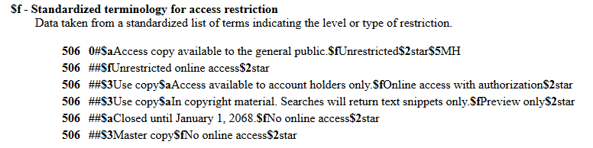
Open Access
The standard 506 field is being used, as defined here: http://www.loc.gov/marc/bibliographic/bd506.html

Slide 5
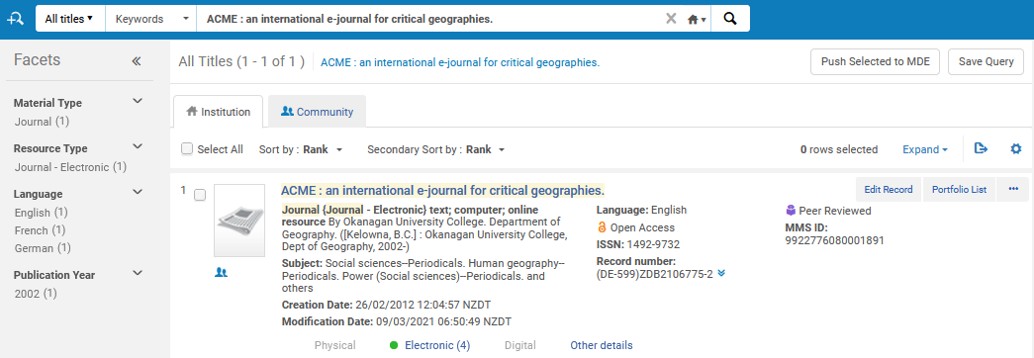
Peer Reviewed
For example, see this search and the repository search results:

Slide 6
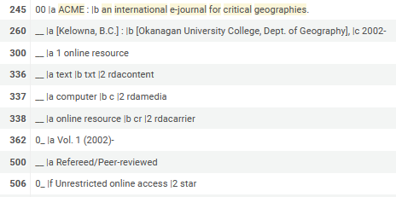
Peer Reviewed
Here is why this record showed both “Peer Reviewed” and “Open Access”

Slide 7
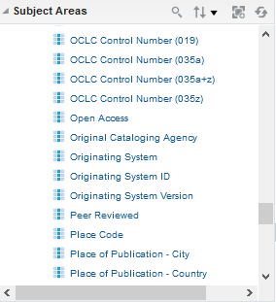
Peer Reviewed and Open Access in Alma Analytics
Both the Peer Reviewed and Open Access appear in the shared folder “Bibliographic Details” in Alma Analytics
The bibliographic details folder appears in all subject areas thus these fields can be used as a filter or for display in all subject areas.

Slide 8
Peer Reviewed and Open Access in Alma Analytics
For the example on the next slide we have an Alma Analytics report from the E-Inventory subject area.
We are displaying both the “Peer Reviewed” and “Open Access” fields for resources, as well as platforms from the COUNTER usage reports and the total usage.
We have filtered by fiscal period 2020.
In some case the platform has usage for “Open Access” resources, and sometimes for “Peer Reviewed” resources, and sometimes for resources which are both “Open Access” and “Peer Reviewed”

Slide 9
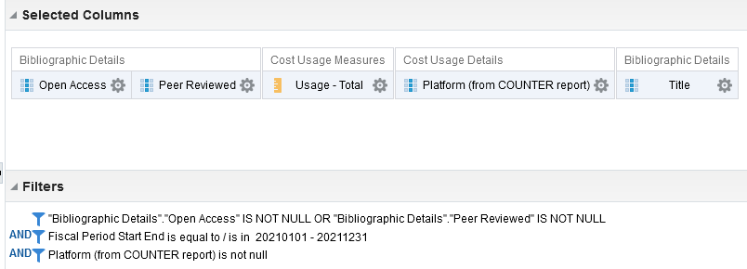
Peer Reviewed and Open Access in Alma Analytics
Criteria tab of the report

Slide 10
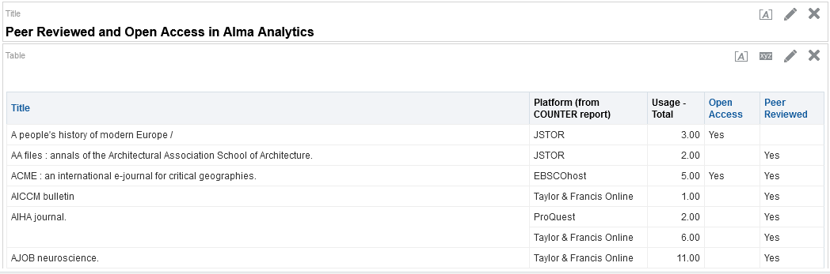
Peer Reviewed and Open Access in Alma Analytics
Results

Slide 11
Yoel.Kortick@exlibrisgroup.com

